Slide 1
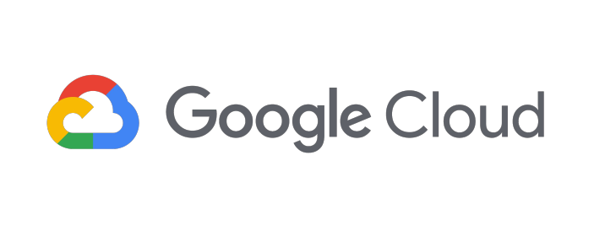
Saurabh Prakash
B.tech / CSE / 4th semester
Roll: 1918676
Graphic Era Hill University

Slide 2
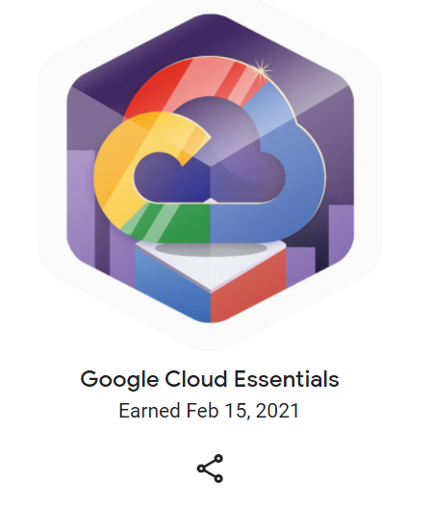
Google Cloud Essentials
Introductory level quest badge
Requires little to no prior knowledge in cloud computing or with Google Cloud
writing Cloud Shell commands
deploying our first virtual machine
running applications on Kubernetes Engine or with load balancing

Slide 3
Labs:
A Tour of Qwiklabs and Google Cloud
Creating a Virtual Machine or Compute Engine: Qwik Start - Windows
Getting Started with Cloud Shell and gcloud
Kubernetes Engine: Qwik Start
Set Up Network and HTTP Load Balancers

Slide 4
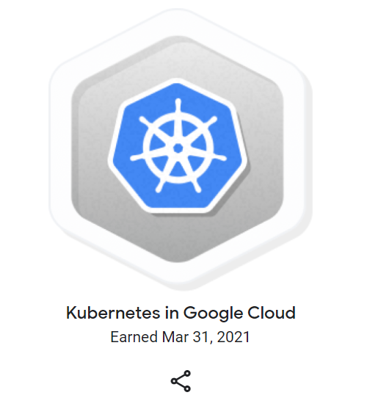
Kubernetes in Google Cloud
Advance level quest
Google Kubernetes Engine was designed specifically to support managed Kubernetes deployments in Google Cloud.
hands-on practice configuring Docker images, containers, and deploying fully-fledged Kubernetes Engine applications
practical skills needed for integrating container orchestration into our own workflow

Slide 5
Labs:
Introduction to Docker
Kubernetes Engine: Qwik Start
Orchestrating the Cloud with Kubernetes
Managing Deployments Using Kubernetes Engine
Continuous Delivery with Jenkins in Kubernetes Engine

Slide 6
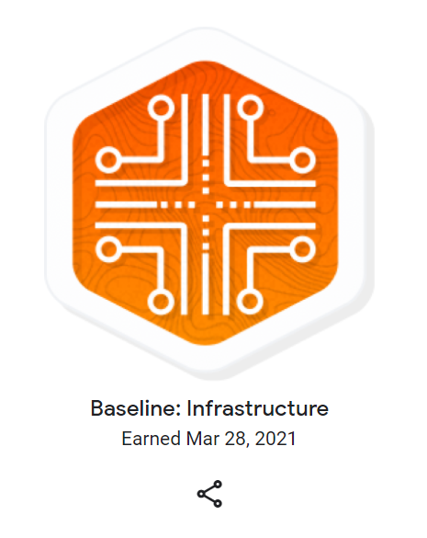
Baseline: Infrastructure
Based on basic understanding of Google Cloud Services
et practical experience through labs that dive into Cloud Storage and other key application services like Stackdriver and Cloud Functions
develop valuable skills that are applicable to any Google Cloud initiative

Slide 7
Labs:
Cloud Storage: Qwik Start - Cloud Console or Cloud Storage: Qwik Start - CLI/SDK
Cloud IAM: Qwik Start
Cloud Monitoring: Qwik Start
Cloud Functions: Qwik Start - Console or Cloud Functions: Qwik Start - Command Line
Google Cloud Pub/Sub: Qwik Start - Console or Google Cloud Pub/Sub: Qwik Start - Command Line or Google Cloud Pub/Sub: Qwik Start - Python or Pub/Sub Lite: Qwik Start

Slide 8
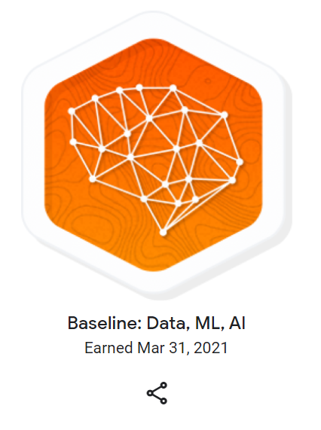
Baseline: Data, ML, AI
This Quest builds on a basic understanding of Google Cloud services.
Deploy a tensorflow model, preparing data for cleaning and analysis, creating Dataproc cluster, cloud natual language API, concept of reinforcement learning and so on

Slide 9
Labs:
AI Platform: Qwik Start
Dataprep: Qwik Start
Dataflow: Qwik Start - Templates or Dataflow: Qwik Start - Python
Dataproc: Qwik Start - Console or Dataproc: Qwik Start - Command Line
Cloud Natural Language API: Qwik Start or Google Cloud Speech API: Qwik Start or Video Intelligence: Qwik Start
Reinforcement Learning: Qwik Start

Slide 10
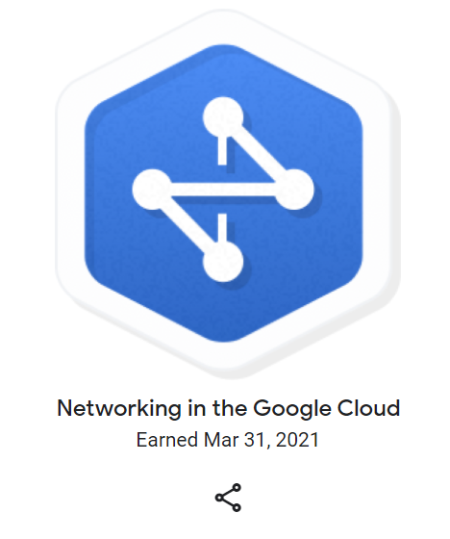
Networking in the Google Cloud
This is fundamental level quest
It will give Practical experience needed so we can start building robust networks right away
From learning the ins-and-outs of VPCs, to creating enterprise-grade load balancers

Slide 11
Labs:
User Authentication: Identity-Aware Proxy
Multiple VPC Networks
VPC Networks - Controlling Access
HTTP Load Balancer with Cloud Armor
Create an Internal Load Balancer
Google Cloud Packet Mirroring with OpenSource IDS

Slide 12
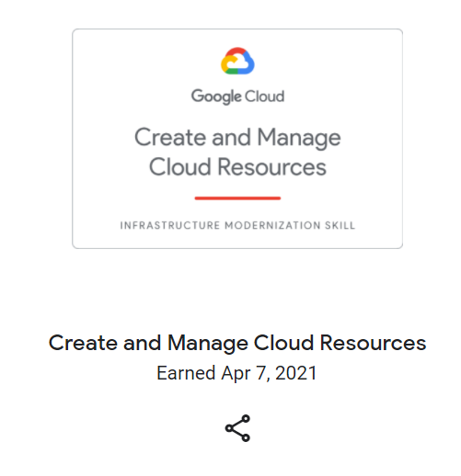
Create and Manage Cloud Resources
It is a skill badge
Writing gcloud commands and use Cloud Shell, create and deploy virtual machines in Compute Engine, run containerized applications on Google Kubernetes Engine, and configure network and HTTP load balancers.
Labs:
A Tour of Qwiklabs and Google Cloud
Creating a Virtual Machine or Compute Engine: Qwik Start - Windows
Getting Started with Cloud Shell and gcloud
Kubernetes Engine: Qwik Start
Set Up Network and HTTP Load Balancers
Create and Manage Cloud Resources: Challenge Lab

Slide 13
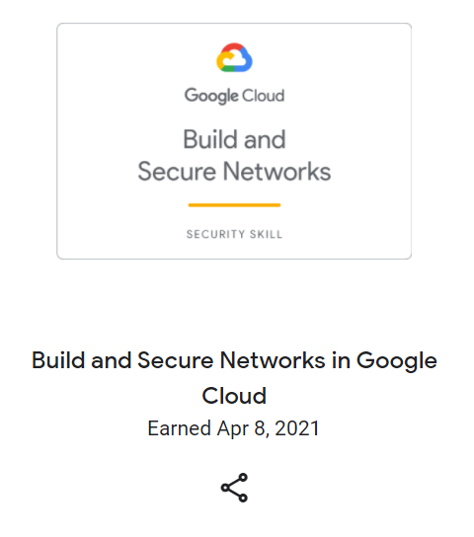
Build and Secure Networks in Google Cloud
It is a skill badge
Learn about multiple networking-related resources to build, scale, and secure our applications on Google Cloud
Create virtual machine instances, Create firewall rules, Configure and test an internal TCP load balancer
Labs:
User Authentication: Identity-Aware Proxy
Multiple VPC Networks
VPC Networks - Controlling Access
HTTP Load Balancer with Cloud Armor
Create an Internal Load Balancer
Build and Secure Networks in Google Cloud: Challenge Lab

Slide 14
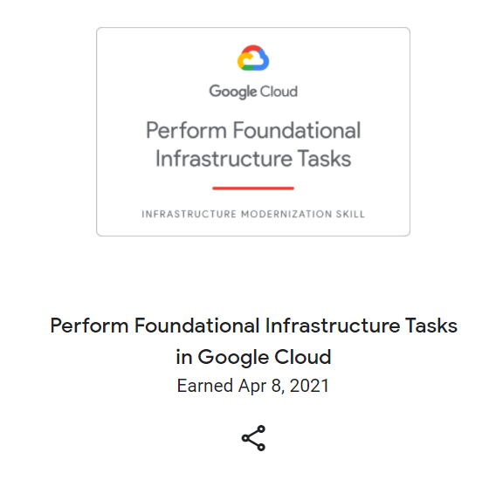
Perform Foundational Infrastructure Tasks in Google Cloud
It is skill badge
Learn how to build and connect storage-centric cloud infrastructure using the basic capabilities of the of the following technologies: Cloud Storage, Identity and Access Management, Cloud Functions, and Pub/Sub.
Labs:
Cloud Storage: Qwik Start - Cloud Console or Cloud Storage: Qwik Start - CLI/SDK
Cloud IAM: Qwik Start
Cloud Monitoring: Qwik Start
Cloud Functions: Qwik Start - Console or Cloud Functions: Qwik Start - Command Line
Google Cloud Pub/Sub: Qwik Start - Console or Google Cloud Pub/Sub: Qwik Start - Command Line or Google Cloud Pub/Sub: Qwik Start - Python
Perform Foundational Infrastructure Tasks in Google Cloud: Challenge Lab

Slide 15
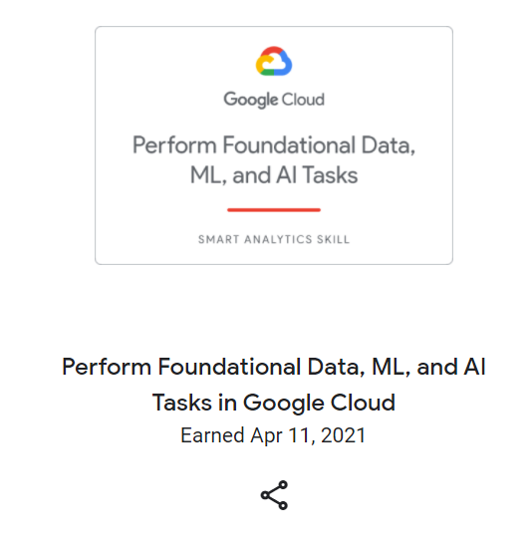
Perform Foundational Data, ML, and AI Tasks in Google Cloud
It is a skill badge
learn the basic features for the following machine learning and AI technologies: BigQuery, Cloud Speech AI, Cloud Natural Language API, AI Platform, Dataflow, Cloud Dataprep by Trifacta, Dataproc, and Video Intelligence API.
Labs:
AI Platform: Qwik Start
Dataprep: Qwik Start
Dataflow: Qwik Start - Templates or Dataflow: Qwik Start - Python
Dataproc: Qwik Start - Console or Dataproc: Qwik Start - Command Line
Cloud Natural Language API: Qwik Start
Google Cloud Speech API: Qwik Start
Video Intelligence: Qwik Start
Perform Foundational Data, ML, and AI Tasks in Google Cloud: Challenge Lab

Slide 16
Thank you...

